Slide 1
Ω Notation

Slide 2
Agenda
Introduction
Example

Slide 3
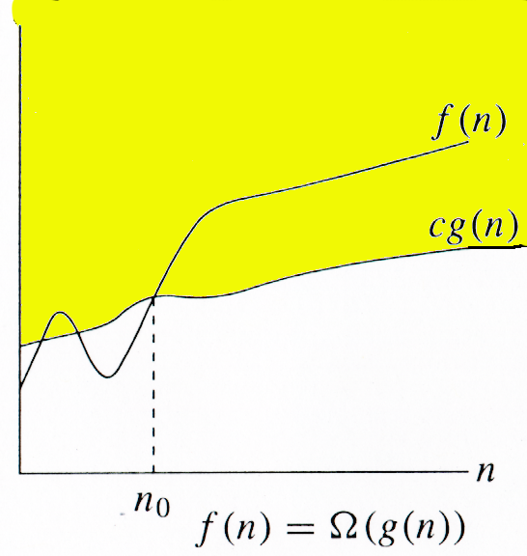
Introduction
It provides a lower bound of f(n) function to a constant factor within.
Given functions f(n) and g(n), we say that f(n) is Ω(g(n)) if there exists positive constants c and n₀ such that for every n > n₀
Then, we have 0 ≤ c g(n)≤ f(n)

Slide 4
Example
f(n) = 10n² - 3n

Slide 5
Summary
We have learned about Ω Notation, along with example.
Ω notation provides a lower bound of f(n) function to a constant factor within.

Slide 6
Thank You
Proprietary content. ©Great Learning. All Rights Reserved. Unauthorized use or distribution prohibited

